Slide 1
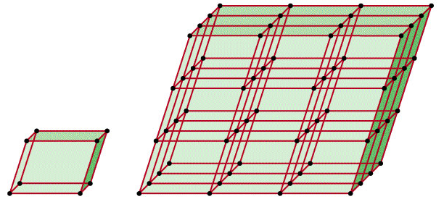
A crystalline solid possesses rigid and long-range order. In a crystalline solid, atoms, molecules or ions occupy specific (predictable) positions.
An amorphous solid does not possess a well-defined arrangement and long-range molecular order.
A unit cell is the basic repeating structural unit of a crystalline solid.
lattice
point
At lattice points:
Atoms
Molecules
Ions
Unit Cell
Unit cells in 3 dimensions

Slide 2
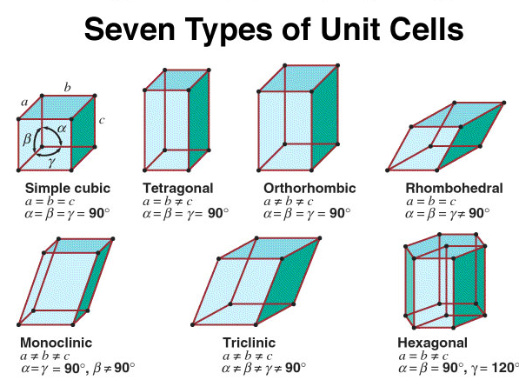

Slide 3
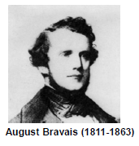
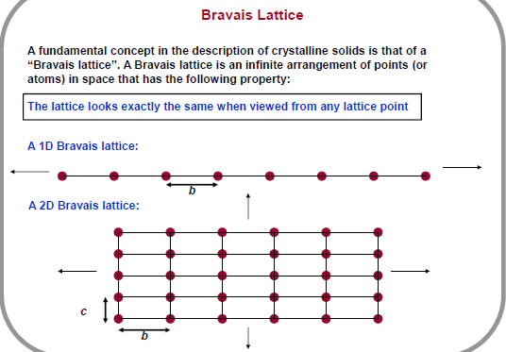

Slide 4
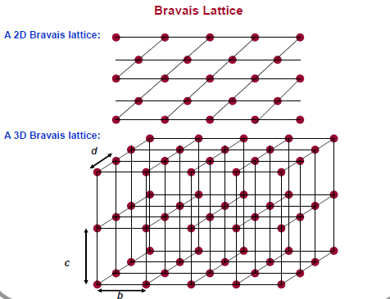

Slide 5
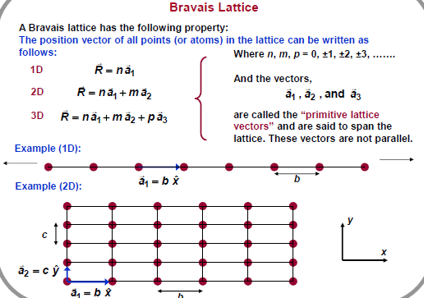

Slide 6
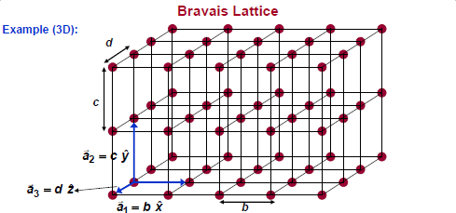

Slide 7
CRYSTAL SYSTEMS AND BRAVAIS LATTICES Seven crystal systems are each described by the shape of the unit cell which can be translated to fill space. Bravais lattices -- fourteen simple and complex lattices within the seven crystal systems. The primitive cell (unit cell) is a fundamental domain with respect to translational symmetry only. In the case of additional symmetries a fundamental domain is smaller. A crystal can be categorized by its lattice and the atoms that lie in a primitive cell (the basis). A cell will fill all the lattice space without leaving gaps by repetition of crystal translation operations.

Slide 8
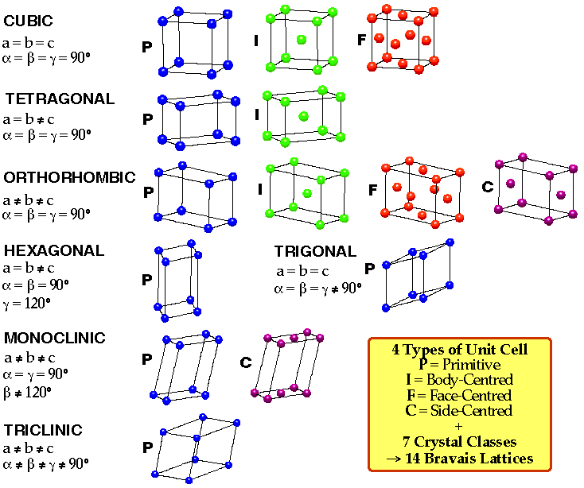

Slide 9
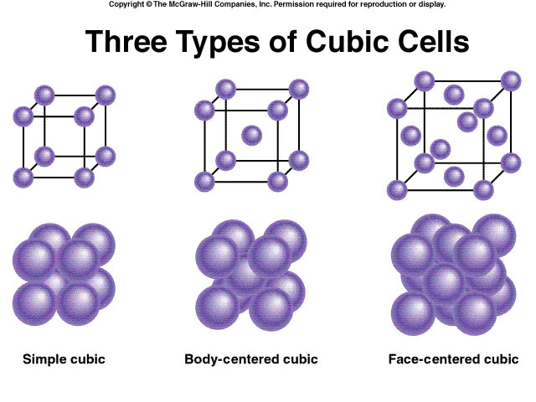

Slide 10
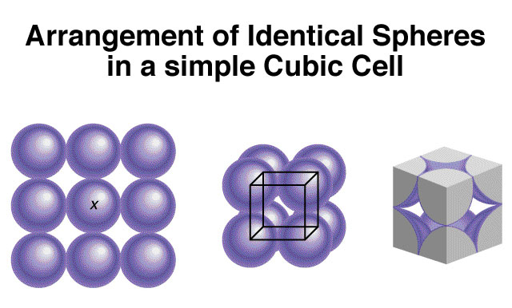

Slide 11
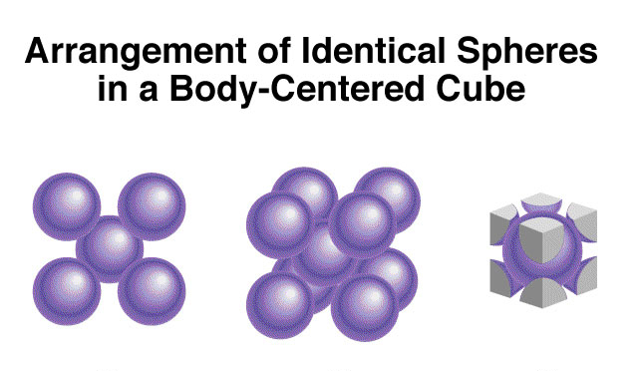

Slide 12
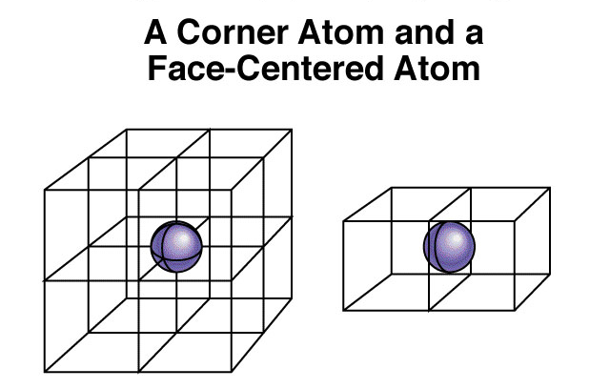
Shared by 8 unit cells
Shared by 2 unit cells

Slide 13
1 atom/unit cell
2 atoms/unit cell
4 atoms/unit cell
(8 x 1/8 = 1)
(8 x 1/8 + 1 = 2)
(8 x 1/8 + 6 x 1/2 = 4)

Slide 14
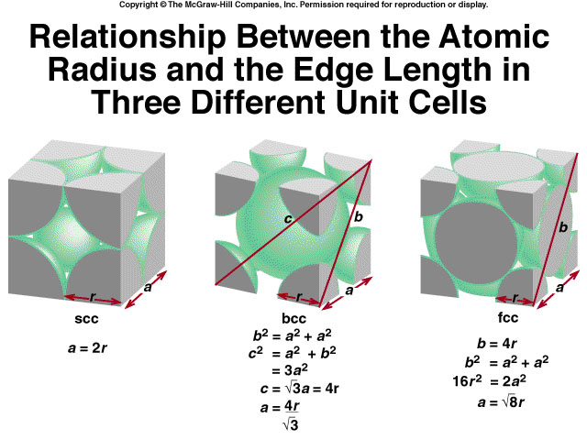

Slide 15
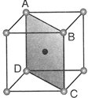


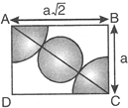

Slide 16

Property | SC | BCC | FCC
Edge length, a | a = 2r | a = (4/√3)r | a = √8 r
Volume of unit cell | a³ = 8r³ | a³ =(4/√3r)³ | a³ = (2√2 r)³
No. of Atoms per unit cell | 1 | 2 | 4
Volume occupied by atoms per unit cell | 1 x (4/3) pi r³ | 2 x (4/3) pi r³ | 4 x(4/3) pi r³
Packing Fraction = | = 0.524 | = 0.68 | = 0.74
% Free space per unit cell | 47.6% | 26% | 32%

Slide 17
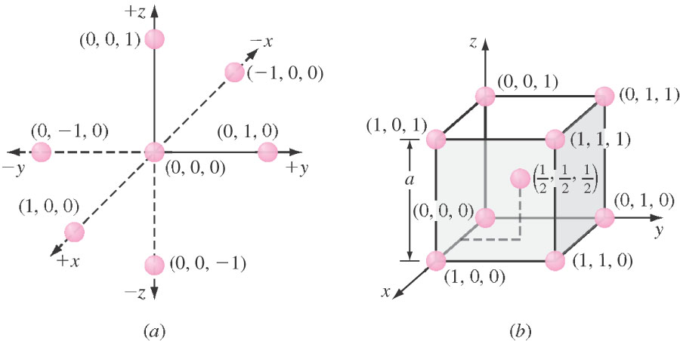
Lattice Sites in an Orthogonal Coordinate System
i.e. Simple Cubic

Slide 18
DIRECTIONS IN CUBIC LATTICES 1 . Vector components of the direction are resolved along each of the coordinate axes and reduced to the smallest integers. 2. All parallel directions have the same direction indices. 3. Equivalent directions have the same atom spacing. 4. The cosine of the angle between two directions is given by

Slide 19
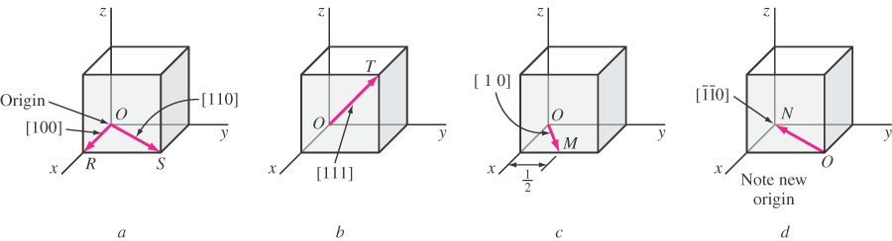
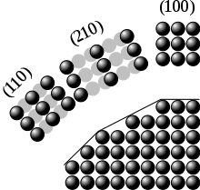

Slide 20
Indices of a Family or Form

Slide 21
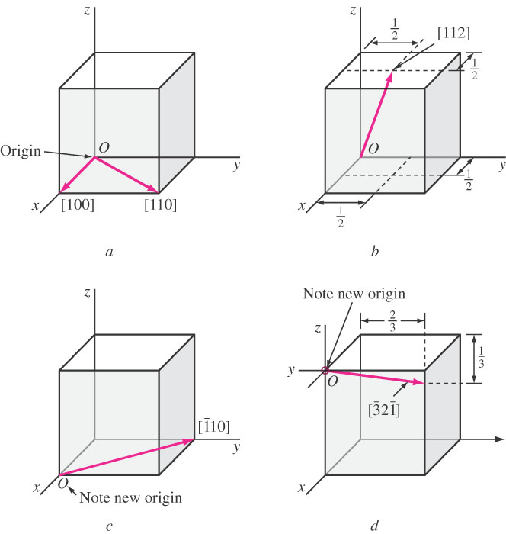

Slide 22
MILLER INDICES FOR CRYSTALLOGRAPHIC PLANES Definition: Miller Indices are the reciprocals of the fractional intercepts (with fractions cleared) which the plane makes with the crystallographic x,y,z axes of the three nonparallel edges of the cubic unit cell.

Slide 23
Spacing between planes in a cubic crystal where d_{hkl} = inter-planar spacing between planes with Miller indices h,k,and l. a = lattice constant (edge of the cube) h, k, l = Miller indices of cubic planes being considered.

Slide 24
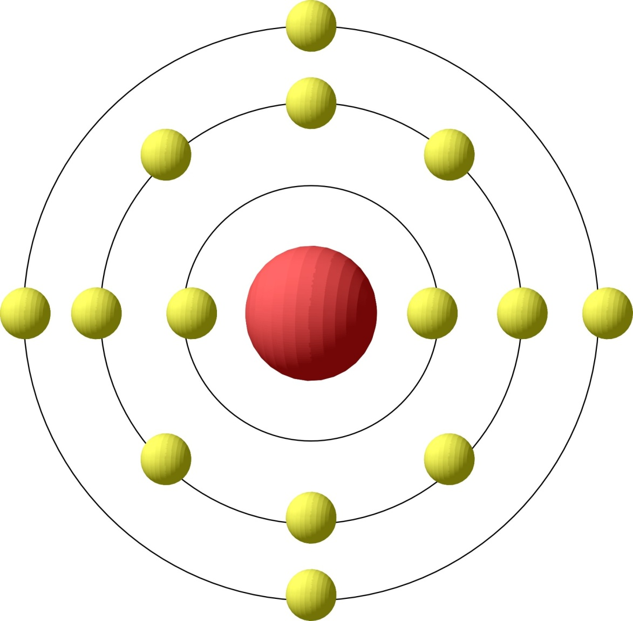
Silicon
Silicon is the primary semiconductor used in VLSI systems
Si has 14 Electrons
Energy Bands
(Shells)
Valence Band
Nucleus
At T=0K, the highest energy band occupied by an electron is called the valence band.
Silicon has 4 outer shell / valence electrons

Slide 25
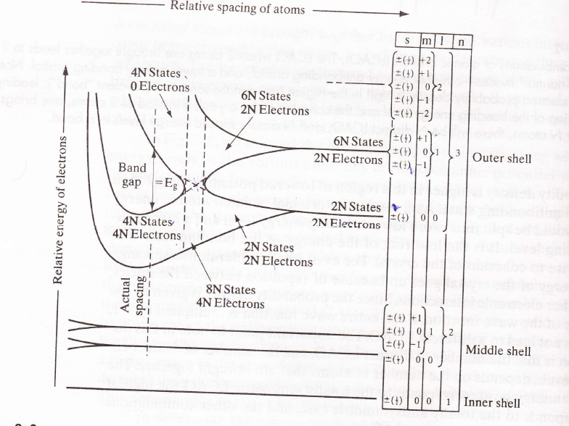

Slide 26
Band Diagrams
E_{C}
E_{g}
E_{V}
Band Diagram Representation
Energy plotted as a function of position
E_{C} → Conduction band
→ Lowest energy state for a free electron
E_{V} → Valence band
→ Highest energy state for filled outer shells
E_{G} → Band gap
→ Difference in energy levels between E_{C} and E_{V}
→ No electrons (e⁻) in the band gap (only above E_{C} or below E_{V})
→ E_{G} = 1.12eV in Silicon

Slide 27
Conductor, Semiconductor or Insulator?
Examples
Silver
Copper
Gold
Silicon
Si/Ge
SiO2
Diamond
Overlapping Bands
- or -
Eg= 10 eV
Partially Filled Bands
Conductor
Semiconductor
Insulator

